Slide 1
Database Testing
Adam Anderson
Notes:
Welcome to Delivering business value faster.

Slide 2
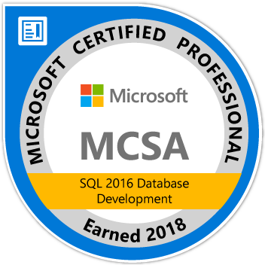
About Me
Adam Anderson
@SQLPioneer
sqlpioneer.wordpress.com
www.linkedin.com/in/adam-anderson-dba
https://github.com/SQLPioneer/
Notes:
My name is Adam Anderson, and I have been a database developer for over 10 years and in IT for more than 20. I am MCSA certified and will be taking my final test in a month or two to get my MCSE.
So I have a friend that is a financial accountant and he always droned on about ROI and how most people didn’t understand it. When I asked what he meant he told me that if you invest 100,000 dollars and a year later you get 12,000 dollars in return that was a 12% ROI and most companies would take that and run. However, if you can start making a 1000 dollars a month it is still the same money

Slide 3
Agenda
Testing Basics
tSQLt
Pester
DBAChecks

Slide 4
Testing Basics

Slide 5
Testing Pyramid
Integration
Functional
Unit Testing
UAT
Automation Increases

Slide 6
Unit Testing
Test Isolation
Order Doesn’t Mater
Single Unit of Work

Slide 7
tSQLt

Slide 8
tSQLt
Unit testing framework
Great for application testing
Allows for mocking objects
Substituting the original with an object that returns a constant
All tests run independently
CLR install Required inside the DB
Functions
Small Procedures
Views
All tests run with no dependency on another test
Add functionality that makes testing easier

Slide 9
tSQLt Functionality
All tests are stored procedures
Tests are organized in classes (schema)
Test classes can contain a setup proc that runs before every test and is rolled back after every test
Everything is wrapped in a transaction
Framework is easily installed and removed

Slide 10
DBAChecks

Slide 11
DBA Checks
Built on Pester
Includes hundreds of Standard DBA Checks
Fully configurable
Describe "a thing" {
Includes Power BI Dashboard
Invoke-DbcCheck -SqlInstance localhost –AllChecks
Get-DbcConfigValue -Name app.sqlinstance
Set-DbcConfig -Name app.sqlinstance -Value localhost
Invoke-DbcCheck -SqlInstance localhost -Check MaintenanceSolution -PassThru | Update-DbcPowerBiDataSource
Invoke-DbcCheck -SqlInstance localhost -Check MaintenanceSolution
Context "thing is shiny" {
It "is true" {$true | should be $true } } }

Slide 12
Data Story
Data Setup
Production Data
Pre-Production
User Acceptance Testing and signoff
Testing
Integration Testing
Development
Supports the business needs
Performance Testing
Experimentation
Unit Testing
Code Work
Security Increases

Slide 13
Environment Use Case Requirements
Production Like
Full Size Dataset
Testing
Full Size Dataset
Dev
Small Dataset
Controlled Environment
Confidential Data
Less Controls
No Confidential Data
No Confidential Data
Little to no Controls

Slide 14
Adam Anderson
@SQLPioneer
sqlpioneer.wordpress.com
www.linkedin.com/in/adam-anderson-dba
https://github.com/SQLPioneer/
Notes:
My name is Adam Anderson, and I have been a database developer for over 10 years and in IT for more than 20. I am MCSA certified and will be taking my final test in a month or two to get my MCSE.
So I have a friend that is a financial accountant and he always droned on about ROI and how most people didn’t understand it. When I asked what he meant he told me that if you invest 100,000 dollars and a year later you get 12,000 dollars in return that was a 12% ROI and most companies would take that and run. However, if you can start making a 1000 dollars a month it is still the same money

